Slide 1

ADVANCED MODELING FOR OPERATIONS
PROJECT PART 1
GROUP 3
DI NACCIO ELIANA 10679691
FERREIRA JOÃO 10975898
GIAMPIETRO LORENZO 10715923
MARTI INES 10988541
ZOCCATELLI LORENZO 10664683

Slide 2
1 INTRODUCTION
CONTENT
2 WEAKNESSES
3 UPDATED VERSION

Slide 3






GOALS AND OBJECTIVES
Objective n° 2
Objective n° 1
Create an updated version of the model that allows achieving:
▪ an average item fill rate at the distribution center higher than 95% before and after the pandemic;
▪ a minimum item fill rate at the distribution center higher than 60% during the
pandemic.
Identify the “weaknesses” of the given model (“BASE CASE”), describing them and commenting on their impact on the model quality

Slide 4

WEAKNESSES:
CUSTOMER BEHAVIOR MODELING
1
2
3
4
In the current model, an anomalous behavior of the demand was identified. The demand is forecasted considering the mean of the 7 days before with demand≠0
In the current model, the customers choose randomly which shop they should visit first. In the real world, every consumer will first visit the closest shop.
In the current model the agents (customers and stores) are activated always in the same order, consequently always the same customers remain without making the purchasing and always the same stores are in stockout.
The customers’ panic behavior is not modeled with a specific criteria, but at each run randomly a certain number of customers are declared panicked, so it is not modeled with a true agent based simulation.
The customers’ panic behavior is not modeled with a specific criteria, but at each run randomly a certain number of customers are declared panicked, so it is not modeled with a true agent based simulation.

Slide 5

WEAKNESSES:
SAFETY STOCKS-DC CAPACITY-
PERFORMANCE INDICATORS
5
6
7
The Item fill rate (IFR) is a great indicator to assess the service level of a supply chain but it’s not enough to understand supply chain resiliance in relation to a disruptive event.
In real context, safety stocks are a common way to cope with risk. The original model lack a modelization of safety stocks, which we believe to be an important inaccuracy in representing a supply chain subjected to unpredictability.
The capacity of the Distribution Center (DC) appears to be drastically undersized based on the demand modeled in the system, leading to very bad supply chain performances

Slide 6
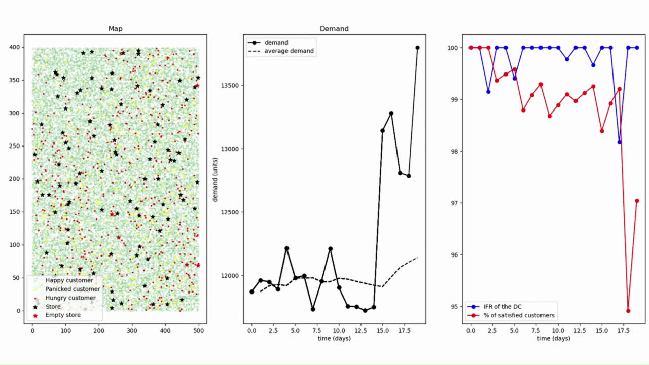
NEW FANCY GRAPHIC LAYOUT!
To better follow the evolution of our model!
Play the video!
To see this layout, set n_run to 1
Map: dots represent customers:
Green: happy customer who managed to buy all the stuff she desires
Yellow: customer who is currently in panic
Red: customer who didn’t manage to find enough food
Daily and average demand of
food
Distribution Centers’IFR (blue) and percentage of satisfied customers (red).
We consider ‘satisfied’ customers all those customers who managed to find all the food they desire

Slide 7

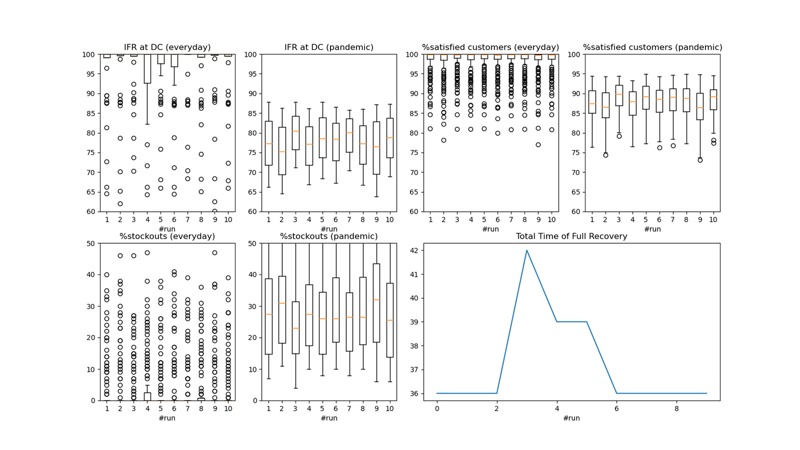
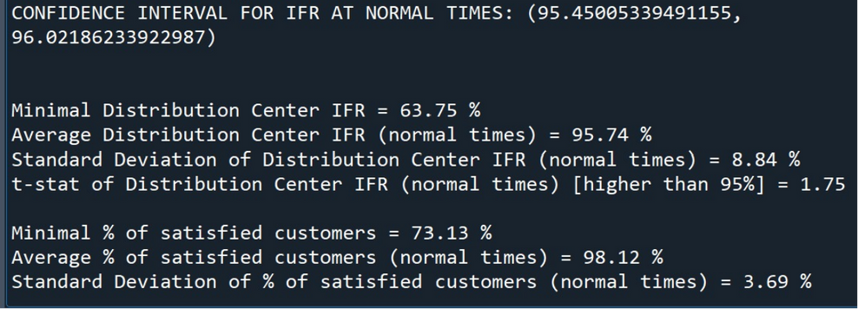
SOME CODE IMPROVEMENTS
If n_run > 1 …
Due to the large computational effort (and therefore time) required to display and update the graph after every step, it is shown only when we simulate only one run. When we simulate the model more than once, our program will only display a final graph to summarize the mean and variance of the variables of interest.
The program will also display the numerical value of average and standard deviation of important indicators
*Total Time of Full Recovery is the time required to return to normal condition after the pandemic starts to spread.

Slide 8

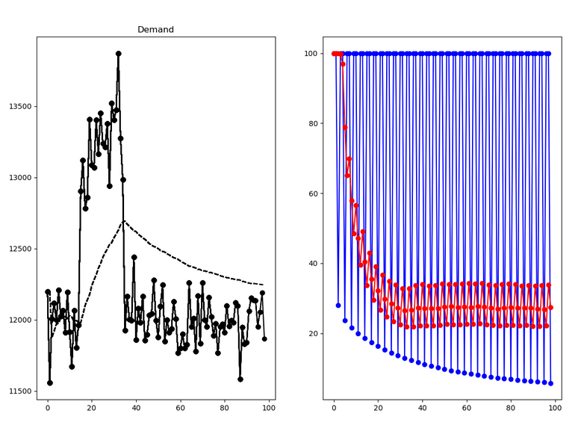

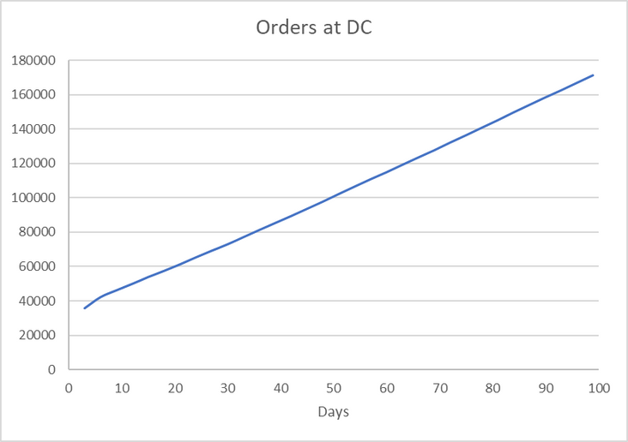

From the original model
WEAKNESS 1
ID DC‘s IFR
% satisfied customers
Prediction of demand: base case
BASE CASE:
Reorder quantity = Expected demand * 1/ reorder frequency
Expected demand calculated with the mean of the last 7 days WITH DEMAND ≠ 0
However an anomalous behavior can be observed:
On one hand, the demand follows a reasonable trend, i.e. a significantly higher values of demand can be observed during the pandemic. After the pandemic, demand goes back to the normal values.
Therefore, why does the IFR not recover at all, and is monotonically decreasing? Upon deeper investigation into this subject, the variable ‘orders_at_dc’ increases monotonically, reaching values of 180.000 orders!, around 3 times what was expected. We would expect the IFR to follow an inverse behaviour to the demand, i.e. decreasing significantly during the pandemic, and then going back to normal.

Slide 9
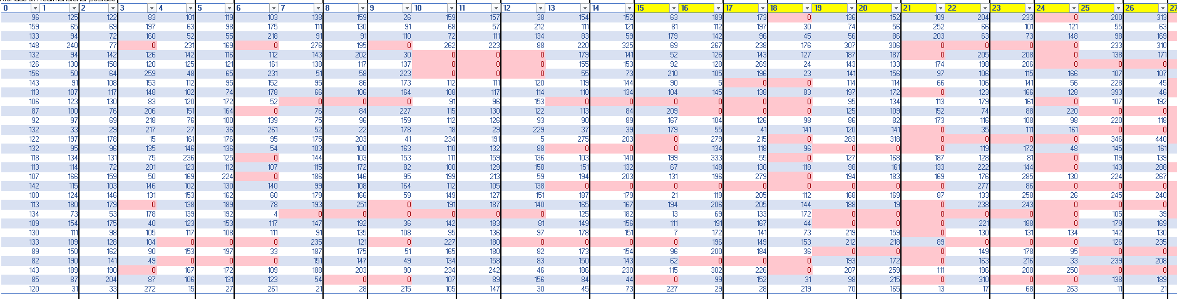

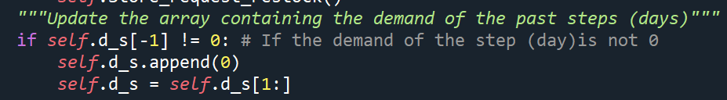
Demand at the stores in a simplified version of the model with lower number of stores and clients
In order to understand the problem, it is crucial to evaluate how the prediction of the DC asks for a replenishment.
As explained in the previous slide, the DC uses the average of the past 7 NON-NULL orders received at the stores (as highlighted in the table: at the seleceted store, the average demand of the day 17 is computed with the demand from days 6-12, since days 13-17 the store does not receive any orders, because it is empty.

Slide 10

Moreover, the behavior of each client is to be understood as follows: when a client visits a store without stock, they will choose a different store.
The problem arises if we combine these two factors: while the clients are reallocated in the grid of stores, the null demand in some of them is ignored (since the average demand is calculated with the days with non-null demand!). In other words, the clients that left the store because it was empty are being recorded in the stores with stock, but also in the empty stores by taking the past non-null data from previous days!
As the simulation moves forward, the number of empty stores increases, and the effect of “duplication” of demand becomes more significant.
Additionally, this problem will exacerbate when the original dimensions of the grid are restored (with a higher number of clients), since the number of stores will become higher. In conclusion, to solve this weakness, having a high number of empty stores should be avoided. This can be achieved either by increasing the capacity and/or number of the DC or by adding safety stocks.

Slide 11
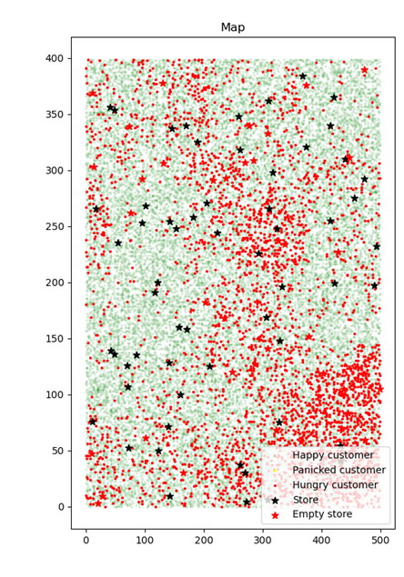
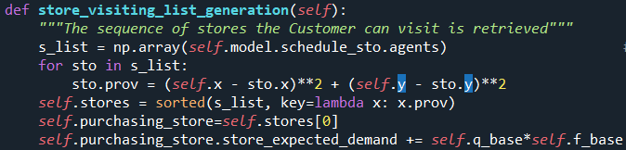
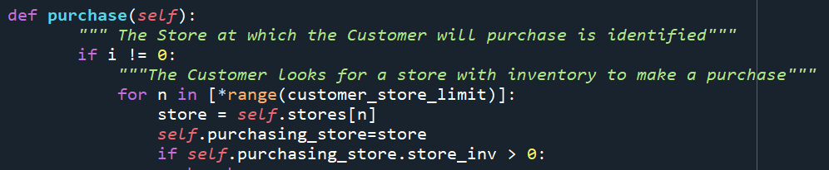
WEAKNESS 2
Each customer receives the list of available shops. In the original version they select a random shop from that list. In the updated version all the stores are sorted according to their distance from the customer itself. The customer will visit the closest store first, then, in case of stock out, she will visit the second closest, and so on.

Slide 12

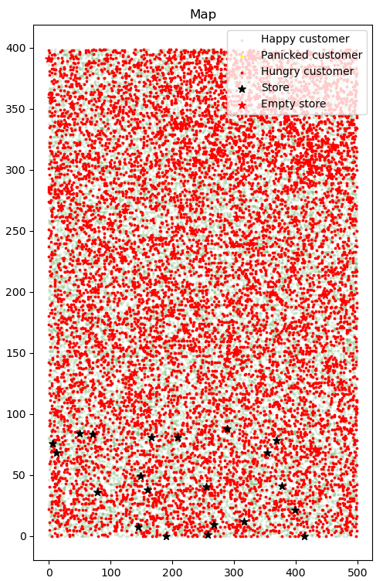
WEAKNESS 3
Base version
Map of the regions with the BaseScheduler: Agents are always activated in the same order, therefore the first stores activated (located in the first regions) will be always the first ones to send their requests to the distribution center (and so they will always plunder the DC), while there will be no more items left for the other stores in the DC.

Slide 13
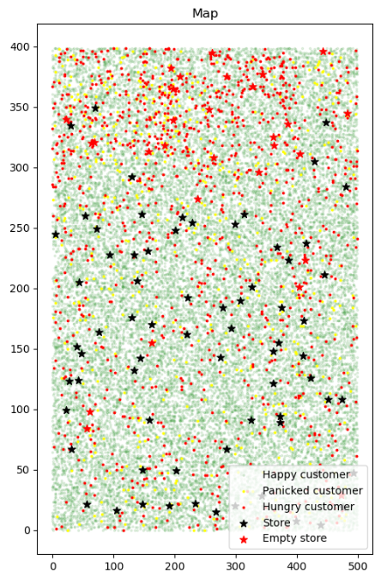
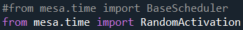
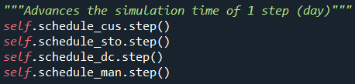
WEAKNESS 3
Updated version
In the original model, the agents are activated in this order:
Customers
Stores
Distribution Center(s)
Manufacturer(s)
To make sure that all the agents of one category are activated randomly but the different categories are always activated in the same order, we created four different schedulers, one for each category.
the graph shows the effects of the updated version of the model and it is possible to notice that the full stores are now randomly distributed in all the space

Slide 14
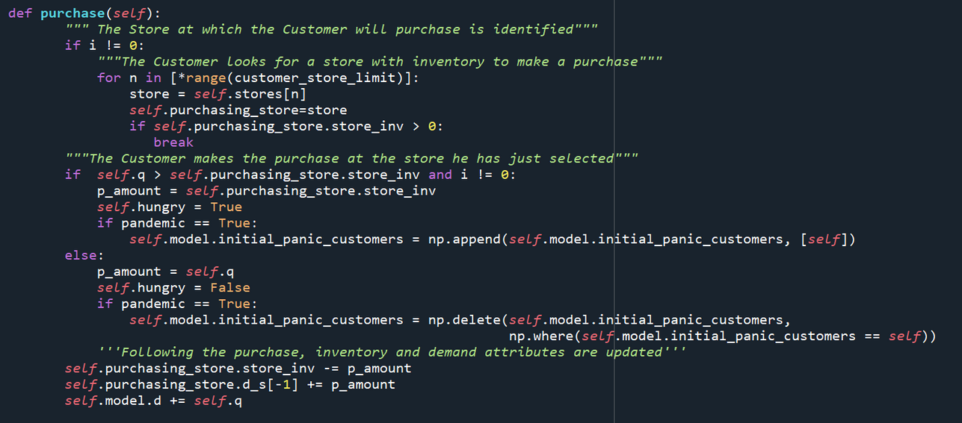
WEAKNESS 4
In the original model, the panic behavior is assigned randomly every day.
In the new model a random assignment of the panic behavior takes place only in the first day of the pandemic.
From this point, harnessing the potential of agent-based simulation, the panic behavior is modeled based on Customer-Store interaction during the pandemic:
If they visit a store in stock-out → PANIC
If they visit a store with some inventory → BACK TO REGULAR BEHAVIOR
After the pandemic, all customers go back to regular behaviour.
Increased realism: because of this rule, customers can now influence each other. In other words, now the number of panicked people is not fixed but the panic will spread from a few customers to many of them.

Slide 15

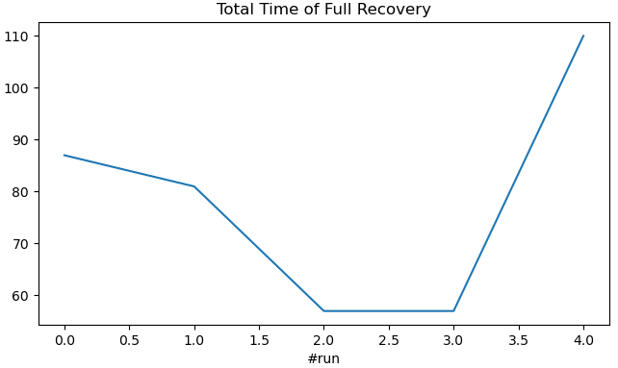
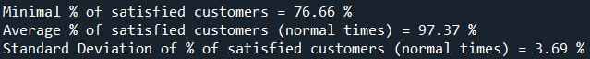
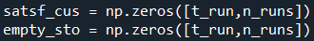
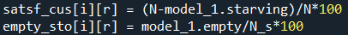
WEAKNESS 5
Additional indicators
The Performance indicators we decided to consider besides the Item Fill Rate are:
Total time of full recovery: Even if the focus of the original model is to simulate the behavior of supply chain following a disruptive event there is no direct indicator to measure resilience, we believe that the total time of full recovery represents a reliable proxy of a system capability to minimize the damage of unpredictable events.
TToFR of each run (5 runs in total)
Final resulted printed at the end of the simulation
Number of satisfied customer: The final objective of a supply chain is to deliver a service level to it’s customer, so tracking their level of satisfaction it’s key to understand how the system is behaving. For retail products, like pasta, the customer will not wait for the next batch to arrive so they move on to the next one until they can satisfy there needs. Therefore we decided to consider a customer as satisfied if it’s able to fulfil it’s need (even if he needs to visit more than one store), otherwise the customer it’s going to be considered as unsatisfied.
Global array to keep track of the satisfied customers in every step
Add the value of satisfied customer after each step (after the function ‘model_1.step()’ had been called )

Slide 16
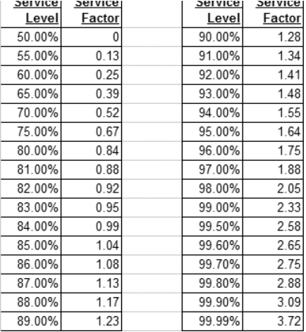
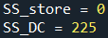
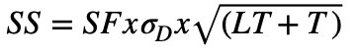
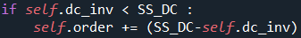
WEAKNESS 6
We introduce safety stocks (SS) in the model:
New global variables:
We computed the safety stocks considering this formula:
The value obtained is 675.
Note that given the assumption of the model no variability of T and LT are considered. The demand considered is the demand seen by the distribution centers, so the overall quantity ordered by the stores per day. We considered to estimate the variability of the demand only the one seen before the disruptive event as we assumed that it rapresented the demand expected by the supply chain for the period so the one that would be uesed to size the safety stocks (Note that the variability was computed as the average standard deviation of the demand before panic buying across 10 runs of code)
We couldn’t compute the Service factor using the Loss integral of the normal distribution as the demand considered doesn’t appear to be normal (P-value shapiro test consistently close to zero across runs) therefore we decided to refer to the conversion table showed beside.
https://www.inventoryops.com/articles/safety-stock.html
In dc_request_restock:
If the inventory stock of a store (or DC) reaches a level lower that SS_store (or SS_DC), the store will add to the order_amount the difference between the desired level of safety stock and the actual size of inventory, to replenish the safety stock

Slide 17

WEAKNESS 7
In the base case model, the capacity of the DC centre appears to be undersized respect to the demand. It assumed in the simulation that the DC centre manages inventories according to the periodic review model, this implies that inventories are reviewed and orders are issued on a fixed frequency. Ideally the maximum quantity that the warehouse must keep has to be equal to the expected demand during the fixed time frame (excluding safety stocks).
Prob (1/f) | Customers | q
1/3 | 27% | 1
1/7 | 61% | 3
1/15 | 10% | 6
1/30 | 2% | 11
DC_capacity = E(Demand) • restock_period • Nclients
restock_period = 3 days
Nclients = 30.000
E(Demand) = ∑(1/f · %Customer · q) = 1/3•0,27•1 + 1/7•0,61•3 + 1/15 • 0,1 • 6 + 1/30 • 0,2 • 11
DC_capacity = 35.889
This is the overall capacity that we found using the mathematical formula, but in the next slide we show the final solution in which we made some adjustments

Slide 18

FINAL SOLUTION
Based on our analysis, we have decided to incorporate safety stocks into our model, leading to a strategic reduction in the overall capacity of our distribution centers. This decision is aligned with both economic and managerial considerations.
Consequently, our final solution entails the operation of three distribution centers (DCs), each equipped with a capacity of 10,500 units and a safety stock level set at 225 units. (Notice that we suppose possible to enlarge a little the capacity of the existing DC)
This configuration results in TOTAL CAPACITY of 31,500 units and a CUMULATIVE SS of 625 units across all distribution centers.
Notably, this is markedly lower than the overall capacity of 35,889 units achieved in the absence of safety stocks.
N.B. We also considered the option of implementing safety stocks at the store level. However, our assessment revealed that such measures weren’t necessary.

Slide 19


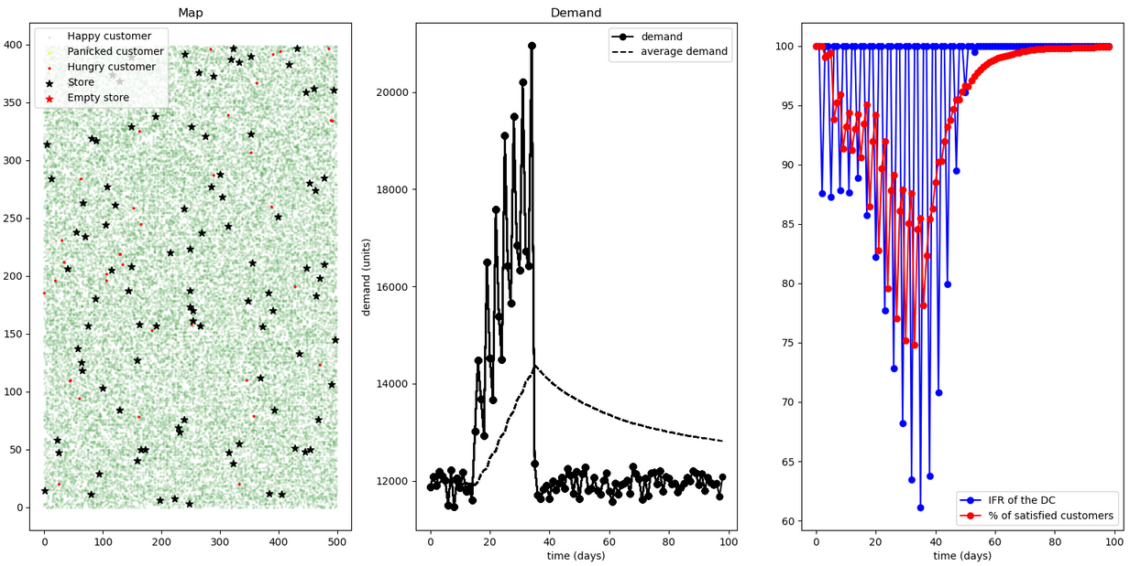
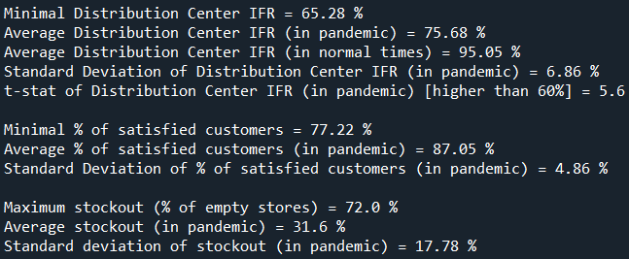
RESULTS
The graph shows clearly that after the pandemic the model quickly reaches good performances (IFR>95%). Additionally, it is noteworthy that the minimum IFR surpasses 60%, and the average IFR consistently exceeds 95%. For precise numerical values, please refer to the code screen.

Slide 20
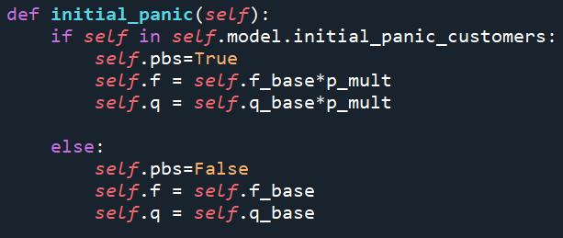
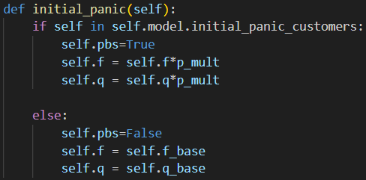
PANIC PURCHASE
NEW code
In the base model, when a Customer falls into panic, her frequencies ‘f’ and quantities ‘q’ is doubled. The problem arises when a Customer is set to panic twice or more in a row. In that case, her ‘f’ and ‘q’ could grow exponentially.
This issue is not significant in the base case, since it is not likely that a customer is randomly set to panic two times in a row.
However, in the new model, where the customers remain in panic unless they find a store in stock-out, this would lead to extremely high demands. In light of this issue, the ‘f’ and ‘q’ of a panic customer are always calculated with respect to the base case.
OLD code

Slide 21

THANK'S FOR WATCHING

